Slide 1

LP5-Assignment 8
Mini Project
Python Online Multiplayer: Rock paper scissors
Esha Anvekar 43205
Vaibhav Bichave 43209
Disha Chavan 43212
Megha Dandapat 43217

Slide 2
Introduction
Making multiplayer games requires the use of various technologies and tools, including programming languages, game engines, and networking libraries. Multiplayer games are frequently made using programming languages including C++, Java, Python, and JavaScript.
A variety of tools are available for creating and managing game materials, physics, animations, and other features in game engines like Unity, Unreal Engine, and Godot.
The ready-to-use networking capabilities offered by networking libraries like Photon, Mirror, and Netty can be included into game engines or game code. These libraries offer functions including server/client communication, game state synchronization, and network latency handling.
A selection of such game development tools are offered by the Python package Pygame. It is constructed on top of the Simple DirectMedia Layer (SDL) library, which gives users access to input devices, graphics, and audio across several platforms. Sprite management, collision detection, and event handling are just a few of the functions and classes offered by Pygame that make it simpler to develop 2D games.

Slide 3
Scope and objectives
A clear understanding of the game mechanics, rules, and requirements, as well as the type of multiplayer experience.
Choosing a networking model for the game, such as client-server or peer-to-pee considering factors such as latency, security, and scalability.
Implementing the necessary networking functionality including features such as sending and receiving data between clients and servers, managing connections, and synchronizing game state across clients.
Form a game logic that handles player input, updates the game state, and sends data to clients.
Testing the game to ensure that it works as expected and is free from bugs and glitches.

Slide 4
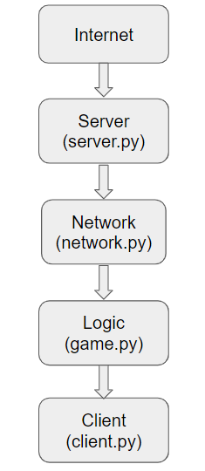
System architecture
The diagram in fig 1. shows the different components of the system and their relationships. The Internet provides the connection between the client and server. The server handles incoming connections from clients, manages game state, and communicates with clients. The network layer provides low-level networking functionality such as socket management and protocol definitions. The game logic layer contains the core logic of the game, such as defining the rules and determining the outcome of each round. The client handles user input, displays game results, and communicates with the server to send and receive game data.
fig 1: System architecture diagram

Slide 5
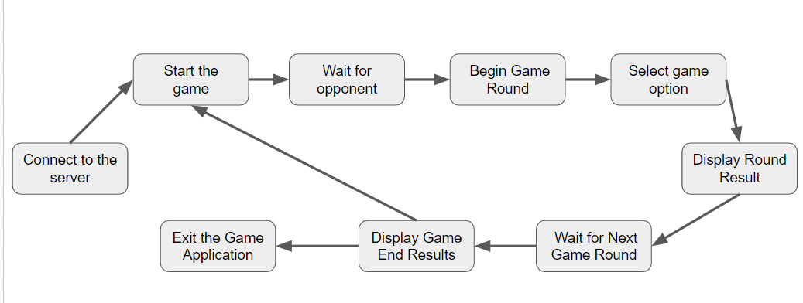
Project flow diagram
This diagram shows the overall flow of the game application from start to finish. The user starts the game, which displays a menu of options. The user selects a game option, which then connects to the server. The user then waits for an opponent to connect and for the game to begin. Once the game starts, the user plays a round of rock paper scissors with their opponent. The application then displays the result of the round, and waits for the next round to begin. Once the game is over, the application displays the final results and the user exits the game.
fig 2: Project flow diagram

Slide 6
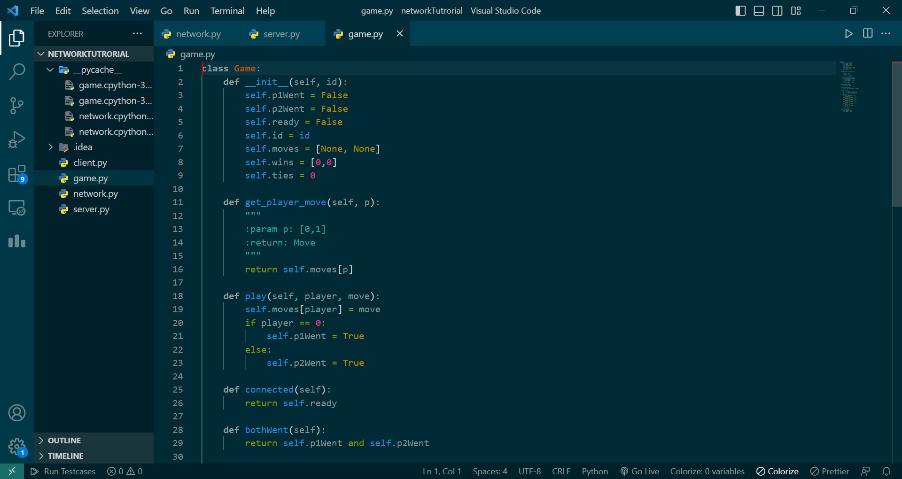
Code and snapshots

Slide 7
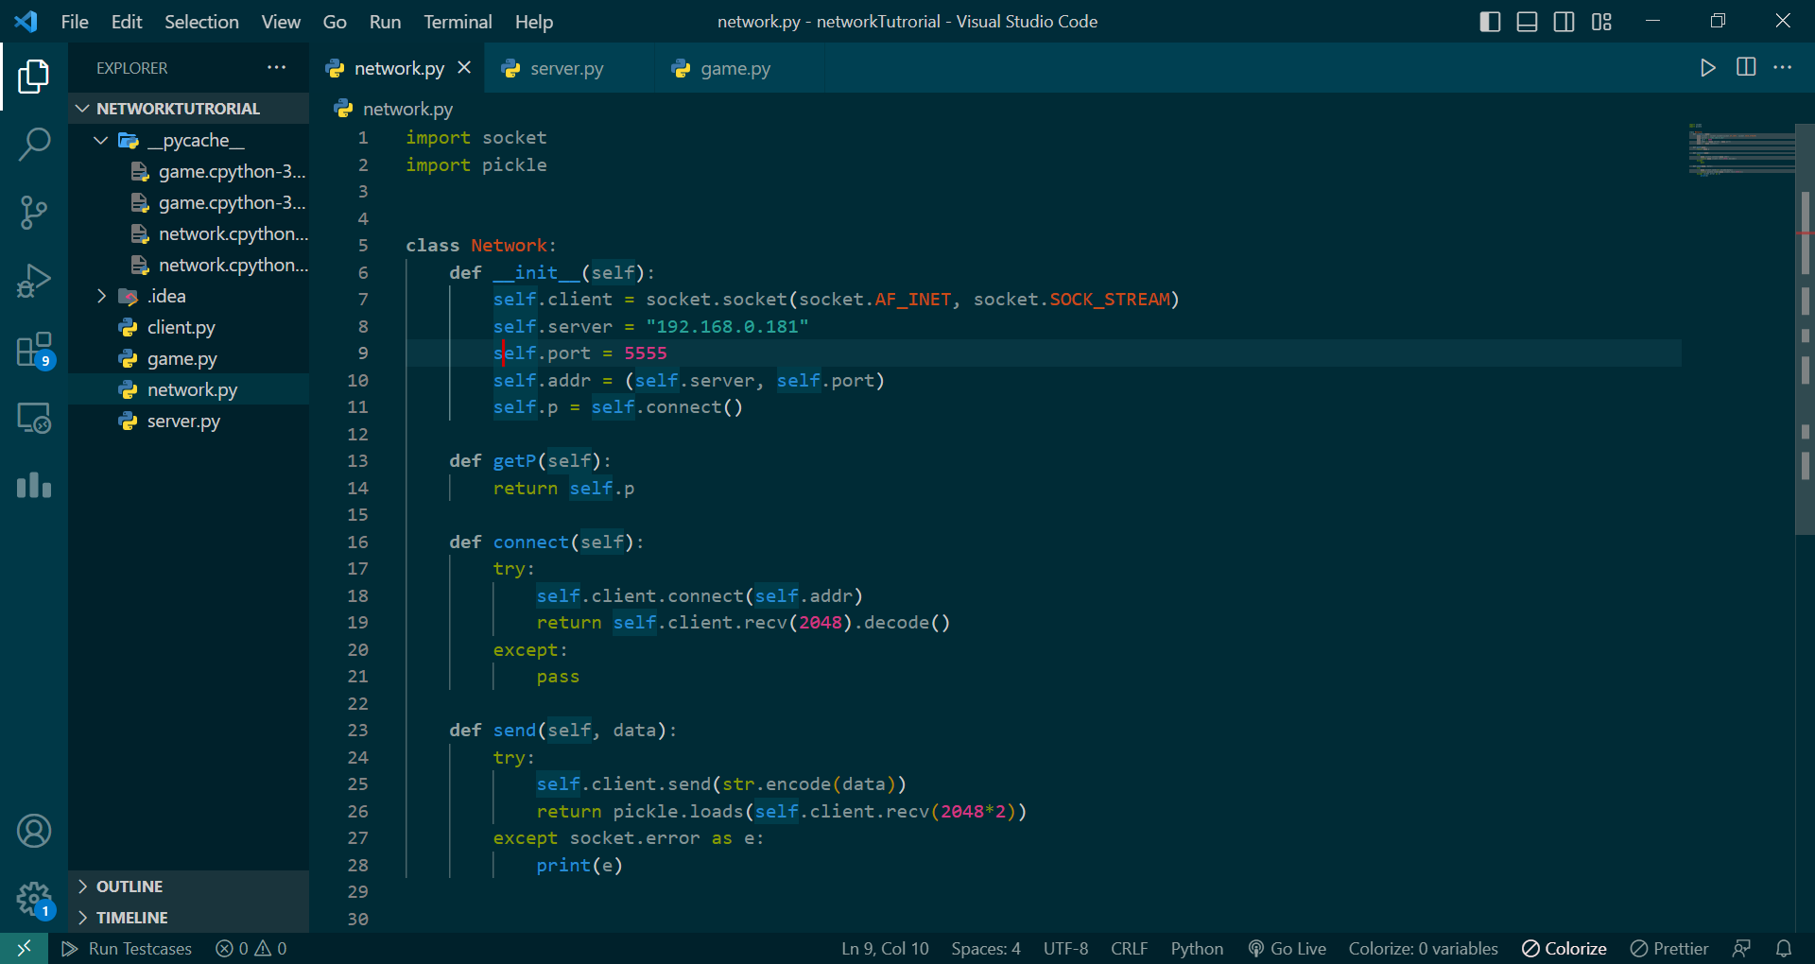

Slide 8
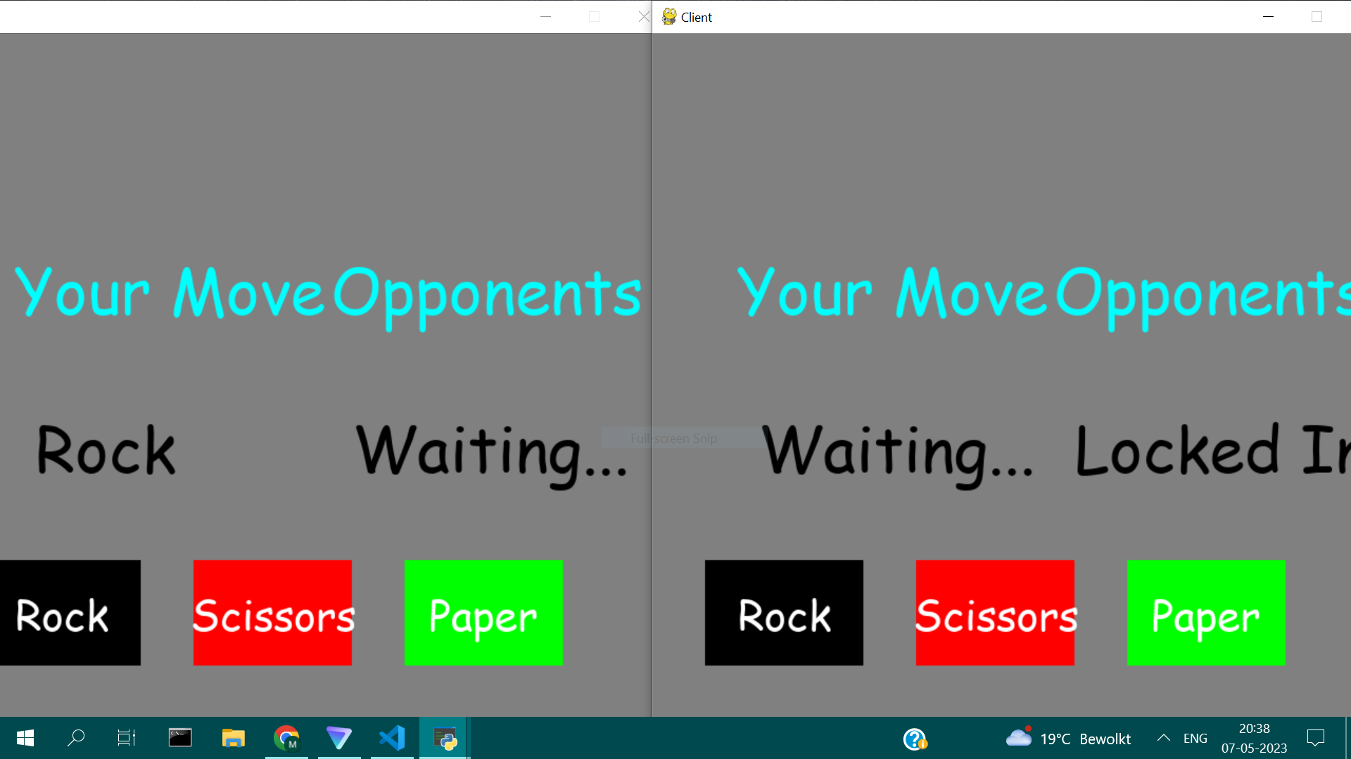

Slide 9
Result
The Rock Paper Scissors is a multiplayer game that demonstrates the use of network programming and graphics programming. The game provides an interactive and engaging experience for players, allowing them to compete against each other over a network connection. The use of sockets and networking programming makes it possible for players to communicate their choices to the server and receive their opponent's choices seamlessly.
The graphical interface developed using Pygame provides a visually appealing display of the game options and the score of each player. The game's logic is implemented in Python, which determines the winner of each round based on the standard Rock Paper Scissors rules.
The project showcases the use of Python, Pygame, and networking programming to create an interactive game that can be played by multiple players. It provides a foundation for future development and enhancements to include additional features, such as artificial intelligence, sound effects, and customization options. Overall, the project is a successful implementation of a Rock Paper Scissors game with networking capabilities and provides an excellent learning opportunity for students and aspiring game developers

Slide 10
Conclusion
In conclusion, the Rock Paper Scissors game developed using Python and Pygame provides an excellent example of how networking can be used to create interactive games.
Moreover, the game's graphical interface developed using Pygame provides an immersive and engaging experience for players, making the game enjoyable to play. The game's use of the standard Rock Paper Scissors rules ensures that the game is easy to learn and understand, making it accessible to a wide range of players.
In terms of future scope, the game can be further improved by incorporating additional features such as a leaderboard, sound effects, and customizable avatars for players. The game could also be expanded to include other classic games such as Tic-Tac-Toe or Chess, which could increase its appeal and attract a broader audience.
Overall, the Rock Paper Scissors game developed using Python and Pygame provides an excellent foundation for future development and is a great example of how networking can be used to create engaging games.

